Slide 1
The Complete Front-End Development course
Javascript ES5

Slide 2
Module 7
ECMAScript
JavaScript vs Java
Popularity and Importance
Basics of JavaScript
JS Statements
JS Functions
Adding JS to your website
Document Object Model
Manipulating DOM
Events
Exception handling
Forms and JS
Cookies
Browser Object Model
Fake namespaces and IIFEs
Best practices
Motivational tips
Assignments

Slide 3

What's ECMAScript?
ECMAScript is the official name of the language.
Standardised scripting language.
Versions- ES5, ES6.

Slide 4
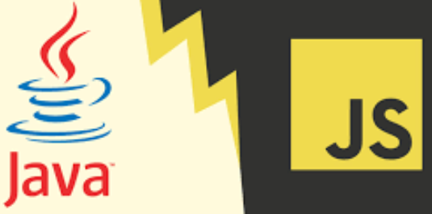
JavaScript vs Java
Interpreted vs compiled
Java- Programming language- Web Applications, Android etc.
Javascript- Scripting and Programming- Web Front-End, Back-End, NoSQL DB.

Slide 5
Popularity of JavaScript
Chosen by most as the first language to learn.
Front-End uses ONLY JavaScript.
Back-End can be created using a framework of JS like Node.js- the most popular framework of JS for this.
NoSQL databases, like MongoDB and CouchDB are based on JS syntax.
The most popular way of data exchange- JSON is based on JS syntax.

Slide 6
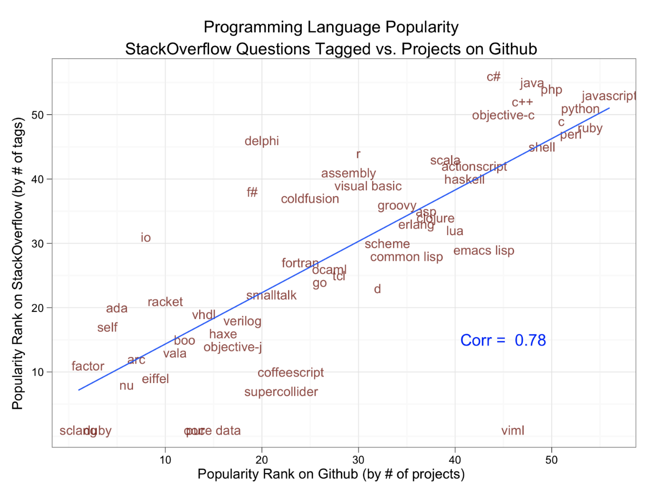
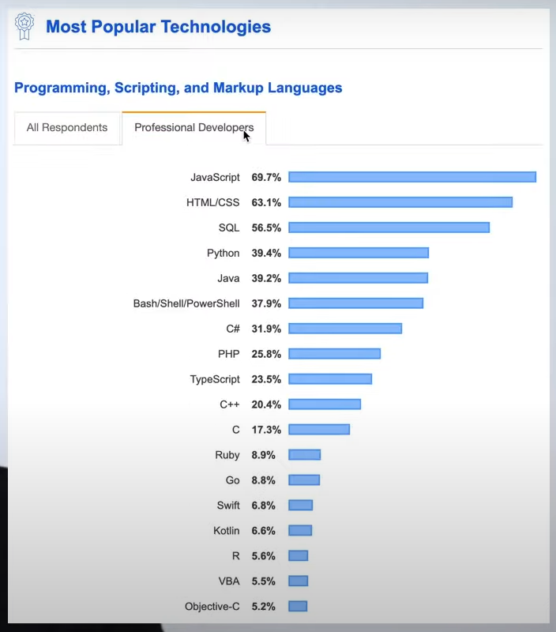

Slide 7

Your first JavaScript program
a
Alert
Confirm
Prompt
Assigning to a var
var a;
a=3;
Literals vs variables
Keywords vs variables
3
Notes:
A simple prompt program to store in a var, alert and confirm pop up show too.
How memory is assigned for vars- animation
var employee = "Elon Musk", carName = "SpaceZ", location = "space";

Slide 8
Naming variables
Cannot contain spaces.
Must begin with a letter, an underscore (_) or a dollar sign ($).
Can only contain letters, numbers, underscores, or dollar signs.
Are case-sensitive.
Keywords cannot be used as variables.
Notes:
JS is case sensitive!

Slide 9

Best practice
Use Camel case names- theAmazingCoder
Give proper,
meaningful names.
Semi colons- to use
or not to use?
Notes:
JS engine puts ;
automatically.

Slide 10
Datatypes
Comments- //… , /* … */
Datatypes
Number
String
Function
Object
Boolean
Array
undefined
JS is dynamically typed.
Notes:
Typeof()
typeof undefined // undefined signified that no value has ever been set. typeof null // object. Null signifies lack of value. null === undefined // false null == undefined // true
Undefined is not NULL

Slide 11
Datatypes
undefined signifies that no value has ever been set.
Null signifies a lack of value.
Number is a floating point type in JS- double precision 64 bit. Integers included in number.
Not defined means never declared.

Slide 12
Creating multiple var
You can create another value based on an existing one but it is created in new memory.
var x=3;
var y=x;
y=4;
x
y
3
3 4

Slide 13


String
Represented with single or double quotes.
Has methods and properties
Length
Concatenation
3 methods for extracting a part of a string:
slice(start, end)
substring(start, end)
substr(start, length)
a
b
c
Notes:
Length()
+ used for concatenation string.
Also +=

Slide 14
Swap
str1
str2
temp
str1
str2
temp
‘Hi’
‘Hello’
‘Hello’
‘Hi’
str1
str2
temp
str1
str2
temp
‘Hello’
‘Hi’
‘Hello’
‘Hi’
Notes:
Program of swapping two string code. Animation of swapping boxes contents

Slide 15
Numbers
var x = 100 / 'string'; // NaN
var x = 3 / 0; // Infinity
var y = -6 / 0; //–Infinity
typeof Infinity; // returns "number"
Notes:
Accuracy-
Example
var x = 999999999999999; // x will be 999999999999999 var y = 9999999999999999; // y will be 10000000000000000
Precision-
The maximum number of decimals is 17

Slide 16

Array
Collection of data
Properties and methods
Different Datatypes in same Array?
Notes:
Var books=[]
Books.includes, push, pop
var cars = new Array("Saab", "Volvo", "BMW");
.length
Foreach, for/in loop
.push(), .pop()
.splice()
.slice()
.sort()
.reverse()
.map() - https://medium.com/dev-bits/a-perfect-guide-for-cracking-a-javascript-interview-a-developers-perspective-23a5c0fa4d0d
.filter(), .reduce(), .reduceright(), .every(), .some(), .indexof(), .lastindexof, .find
Different datatypes possible in same array eg string, int, function, object.
myObj.prop or myObj[prop] is same.

Slide 17
Type Conversion
Automatic type conversions
Type coercions- one type to another automatically on the fly.
Beware of type conversions!
Notes:
'5' + 5 = 55 and '5' - 5 = 0

Slide 18
Operators
Arithmetic operators
Assignment operators
Logical operators
Conditional operators
=== or == ?
Notes:
=== also takes care of datatype
False- null, undefined, “”, 0, NaN all are false
Everything else is true.
True || false //true
“Hello” || “” //Hello
True && false //false
So can use default for undefined values as- sideDish || “whatever” //will return sideDish as || will return first true thing or will return whatever if sideDish is undefined.

Slide 19

Conditional statements
To be or not to be?
The if statement
The if else statement
The else if statement
The switch statement
The break keyword
Notes:
Code FizzBuzz problem

Slide 20

Iterative statements- Loops
Make hay while the sun shines
For loop- fixed iteration
While loop- depends on state
The continue keyword
The foreach loop

Slide 21
Functions
In built functions
Why create functions?
Reuse
A single concern for each function
What 3 types of functions we just talked about?
Notes:
Calculator eg. With if else, switch , then functions, then function with different params
Just like we use 1 external style sheet for all pages of our website for uniformity and DRY and avoiding hassle, we use functions in JS
Their allocation in memory
Arguments in it are defined with out var.
Use eg of gifting function
Function a () {}
Or var a = function () {}
Both are same.
Call as a(); invoking it
In built functions eg math functions

Slide 22
Functions
When does the function execute?
When an event occurs and function is called
When it is called from the JavaScript code
Automatically (self invoked)
All arguments in JS function are optional!
Variables created without a var keyword are global, even if they are created inside a function.
Notes:
Make gifting self invoking function on certain occasions

Slide 23
Pass by values, Pass by reference
In JavaScript, primitives are passed by values and objects including arrays are passed by reference.
Pass by value-
function test(y) {
y++;
console.log(y);
}
x = 3
test(x)
console.log(x);
x
y
3
3 4
Notes:
Javascript always pass by value so changing the value of the variable never changes the underlying primitive (String or number). However, when a variable refers to an object which includes array, the value is the reference to the object
Add eg of pass by value and reference in the gifting function

Slide 24
Pass by reference
function test2(y) {
y.a++;
console.log(y.a);
}
x = {a: 2};
test2(x);
Console.log(x);
x
y
x
y
a:2
a:3

Slide 25
Scope
Local variables and global variables
Global- available everywhere.
Functional scope- variables and functions defined here are available only within this function.
Function can have functions in it.
Notes:
Show scopes with the gifting function

Slide 26
Sorting and Comparing
Important for interviews
By default, the sort() function sorts values as strings.
You can fix this by providing a compare function.
Notes:
Example
var points = [40, 100, 1, 5, 25, 10]; points.sort(function(a, b){return a - b}); //b-a for descending

Slide 27
setTimeout(), setInterval()
What is the difference between setTimeout() and setInterval() methods?
setTimeout(expression, timeout);
setInterval(expression, timeout);
Notes:
setTimeout(expression, timeout);
It runs the code with the timeout. This function executes the JavaScript statement "AFTER" interval.
setInterval(expression, timeout);
It runs the code in fixed time intervals depending upon the length of their timeout period.

Slide 28

Callbacks
Why callbacks?
Callback functions
Higher order functions
Notes:
To change the function to be called for specific arguments on the fly- use eg of calculator function.
Higher order functions. JS uses this heavily compared to any other lang
Use chrome debugger to demonstrate the flow.
Add a callback to the gifting function.

Slide 29

JavaScript Objects
“Object” oriented programming
Properties- color, type, dial, condition…
Methods- ring, pick, hangup, disconnect…
Notes:
Eg of product object for our ecommerce website cart.
myObj.prop or myObj[prop] ?

Slide 30
JavaScript Objects
Dates, Arrays, Functions are all objects
Objects are mutable: They are addressed by reference, not by value.
objectName.property
objectName["property"]
objectName[expression]
delete objectName.property;
x
y
a:2
Notes:
var person = new Object();
Var person={}

Slide 31
Displaying Objects
Some common solutions to display JavaScript objects are:
Displaying the Object Properties by name
Displaying the Object Properties in a Loop
Displaying the Object using Object.values()
Displaying the Object using JSON.stringify()
Notes:
The For-in loop
Loop through all gifts and display, obj.keys and obj.values, obj.freeze and obj.seal.

Slide 32
Adding JS to website
Inline, internal and external JS
DOM should be loaded to manipulate it.
Placing scripts at the bottom improves the display speed- script interpretation slows down the display.
JS is sequential in execution.
Notes:
JavaScript is already running in your browser on your computer, on your tablet, and on your smart-phone. Free to use for everyone.
Only JS can be used for browsing scripting
First test if your .js file is linked properly in your html with an alert
Body onload
Button onclick
“alert (’Hello World’)”
Mostly js at end and css in head. Coz
In script, type javascript is not required actually. Always required to have closing script tag.
Can include js in head, in body. Include inserts that code right at that place.
Add multiple JS in page one after another to show sequential nature.
<script>
document.getElementsByTagName("button")[0].onclick = function () {
alert("Hello World!");
};
</script>

Slide 33
Displaying
innerHTML
document.write()
window.alert()
console.log()

Slide 34
Document Object Model (DOM)
DOM tree- a tree of objects/elements
All DOM objects have properties and methods
Selectors for getting the objects in your DOM
Setting properties
Calling methods
Notes:
Show in chrome using html tree generator
Document is instanceof HTMLDocument.
Car.color = red //set
Color = car.color //get
Methods= car.drive() //diff from functions as methods are only on obj
Html tree generator extension chrome
getelementbytagname, getelementbyid, getelementbyclassname, Document.querySelector() // all css selector ways. Only returns first match. If need all use querySelectorAll which returns array.
getElementsByTagName() method returns an HTMLCollection object like an array

Slide 35
Document Object Model (DOM)
All CSS can be changed using JS- use camelCased names of CSS properties
Using .css is not the best practice!
Instead use JS to just add or delete classes
So two types of objects
DOM objects
Non DOM objects
Notes:
.innerhtml, .style // all css can be changed using this except that all are camel cased and values in JS always strings but this is not best practice so get classes using .classList and .add for adding stylesheet classes we can use JS to just add or delete classes, .firstchild, .length, .click(), .attributes() gives list of all attributes of the tag. .getAttribute(“attrname”) gives value of the attr. .setAttribute(href, “”)
How to know if an obj is a DOM object or not?
Obj instanceof Element returns true or false.

Slide 36
Events
DOM objects also have events
So many event types! So much power!
Element.addEventListener("mousemove", myFunction)- has a callback function or an anonymous function definition
Element.removeEventListener("mousemove", myFunction);
Notes:
eventtypes- https://developer.mozilla.org/en-US/docs/Web/Events
Eg. Leaving website popups (modals)
Document.querySelector().addEventListener(“click”, sayhello);

Slide 37
Event Bubbling and Event Capturing
Event bubbling and Event capturing are two ways of event propagation in the HTML DOM API when an event occurs in an element inside another element, and both elements have registered a handler for that event.
The event propagation mode determines in which order the elements receive the event.
Notes:
https://medium.com/dev-bits/a-perfect-guide-for-cracking-a-javascript-interview-a-developers-perspective-23a5c0fa4d0d

Slide 38
Bubbling
Capturing
<body>
<body>
<div>
<div>
<ul>
<ul>
<li>
<li>
click
click
Notes:
Show code for this

Slide 39
Controlling Event Handlers
Event.preventDefault()
stopPropagation()
stopImmediatePropagation()
Notes:
The preventDefault() function is used to prevent the default action the browser performs on that event, whereas the stopPropagation() method stops the game from bubbling up to the event chain. The divs click handler never works with stopPropagation(). With preventDefault(), the divs click handler works but browsers default action gets stopped.
document.querySelector("#id-checkbox").addEventListener("click", function(event) { document.getElementById("output-box").innerHTML += "Sorry! <code>preventDefault()</code> won't let you check this!<br>"; event.preventDefault(); }, false);
<p>Please click on the checkbox control.</p> <form> <label for="id-checkbox">Checkbox:</label> <input type="checkbox" id="id-checkbox"/> </form> <div id="output-box"></div>
This can be used specifically to not allow user to go ahead with normal task to avoid any errors eg not using special symbols in email id field etc.
https://developer.mozilla.org/en-US/docs/Web/API/Event/stopPropagation

Slide 40
Traversing DOM Elements
<title>
<head>
<meta>
<html>
<h1>
<body>
<p>
Notes:
parentNode
childNodes[nodenumber]
firstChild
lastChild
nextSibling
previousSibling
var myTitle = document.getElementById("demo").childNodes[0].nodeValue;

Slide 41
Adding and Deleting Elements
<html>
<head>
<body>
<title>
<h1>
<p>
Attribute “id”
<meta>

Slide 42
JS form Validation
HTML form validation can be done by JavaScript.
Client side validation is performed by a web browser, before input is sent to a web server.
You can cause automatic submit without submit button using document.form[0].submit();
Notes:
<form name="myForm" action="/action_page.php" onsubmit="return validateForm()" method="post"> Name: <input type="text" name="fname"> <input type="submit" value="Submit"> </form>
function validateForm() { var x = document.forms["myForm"]["fname"].value; if (x == "") { alert("Name must be filled out"); return false; } }

Slide 43
Browser Object Model (BOM)
The Browser Object Model (BOM) allows JavaScript to "talk to" the browser.
The Window object
window.innerHeight
window.innerWidth
window.open()
window.close()
window.moveTo()
window.resizeTo()

Slide 44
The Screen object
The window.screen object can be written without the window prefix.
screen.width
screen.height
screen.availWidth
screen.availHeight
screen.colorDepth
screen.pixelDepth

Slide 45
Other Window Objects
window.location.href returns the href (URL) of the current page.
window.location="http://www.newlocation.com"; .
The window.navigator object contains information about the visitor's browser.
javaEnabled()
cookieEnabled
history.back() - same as clicking back in the browser
history.forward() - same as clicking forward in the browser

Slide 46
Cookies
How to remember information about the user?
Cookies let you store user information in web pages- Name Value pairs
Stored in small text files on your own computer.
When the user requests a web page from a server, cookies belonging to the page are added to the request. This way the server gets the necessary data to "remember" information about users.
How to get and set cookies?
Notes:
https://www.amazon.com/gp/help/customer/display.html?nodeId=201890250#:~:text=Amazon's%20cookies%20allow%20you%20to,some%20of%20Amazon's%20essential%20features.&text=Third%20parties%20use%20cookies%20in,services%20on%20behalf%20of%20Amazon.
When a web server has sent a web page to a browser, the connection is shut down, and the server forgets everything about the user.
When a user visits a web page, his/her name can be stored in a cookie.
Cookies are saved in name-value pairs like:
username = John Doe
document.cookie will return all cookies in one string much like: cookie1=value; cookie2=value; cookie3=value;
document.cookie = "username=John Doe; expires=Thu, 18 Dec 2013 12:00:00 UTC; path=/";
var x = document.cookie;
var username = getCookie("username");

Slide 47
Exception handling
try {
// Block of code to try
}
catch (err) {
// Block of code to handle errors
}
finally {
/* Block of code to be executed regardless of the try catch result */
}
Try
Catch
Throw
Finally
Notes:
try { Block of code to try } catch(err) { Block of code to handle errors } finally { Block of code to be executed regardless of the try / catch result }
<p id="demo"></p> <script> try { adddlert("Welcome guest!"); } catch(err) { document.getElementById("demo").innerHTML = err.message; } </script>

Slide 48
Best practices
Beautify your code
Add comments
Focus on readable and understandable code instead of just reducing lines of code
All declarations on top
Initialise as you declare
Remember the semi colon!
Modularise your code into functions catering to a single activity
You can use higher order functions and callbacks for this.
Avoid global variables
Avoid ==, use === always
Using “strict”
Notes:
https://github.com/rwaldron/idiomatic.js/
‘use strict’ introduced in ES5, allows to restrict syntax to JS so its fails less silently.
"use strict"; x = 3.14;
myFunction(); function myFunction() { y = 3.14; // This will also cause an error because y is not declared }

Slide 49
Improve performance of your code
Reduce activity in your loops
Reduce DOM accesses
Avoid unnecessary variables
Avoid creating objects/data with new
Notes:
Think how to implement swap method without using third variable

Slide 50
Summary
Defining data
Operators on data
Loop through data
Defining and invoking functions
Using timeout function and callbacks
Displaying data
Accessing and manipulating DOM using JavaScript
Event handling
BOM objects
Exception handling
Industry best practices

Slide 51
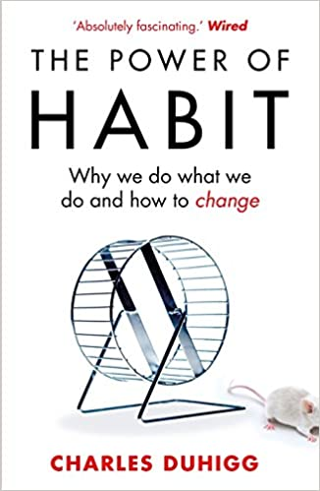
Motivational tip
Building a habit
The habit loop
Cue, routine, reward.
Craving
Keystone habits

Slide 52
Assignment
Add behaviour in your ecommerce homepage using Javascript-
With change in dropdown value, change the flag and the support contact number.
Create the blue button on bottom to reach the top of the website again.
Make the navigation bar “sticky”

Slide 53
Answer the following Questions
What are the features of the JavaScript language?
What are the drawbacks of cookies?
What are the different types of Error Name values in JavaScript?
What do you understand by cookies? How will you create, read, and delete a cookie using JavaScript?
Please explain the Strict mode in JavaScript. Also, tell how to enable it.
What role do deferred scripts play in JavaScript?
What do you understand by Screen objects? State their various properties.
Is Javascript a dynamically typed language or a static typed language?
List all differences between JavaScript and Java

